Slide 1
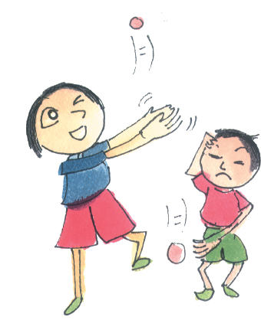
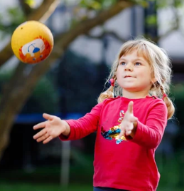
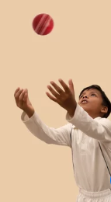
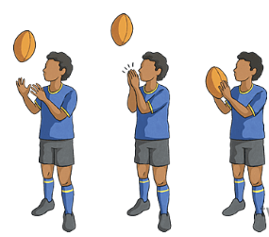
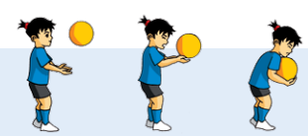
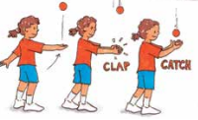
How many times can you throw and catch a ball in a row without dropping it? Try the same activity using a different size ball.
How many times can you clap your hands together before catching the ball?
Are you ready for the
throw/clap/catch challenge?
Try the same activity using different size balls.
How high can you throw the ball in the air AND catch it?
How many throws and catches can you do with a partner before dropping the ball?
Send us photos or videos of your challenge ideas to sspadmin@combertonvc.org or share them on the SSP Facebook or twitter page

Slide 2
Active Play – Throw/Clap/Catch Challenge
Vid’s to inspire your kids!
https://www.youtube.com/watch?v=F3ndm1Wlq3g
Top 5 best cricket catches of ALL time!
https://www.youtube.com/watch?v=7Uibp7GOQGc
Ultimate frisbee – top ten plays 2022 season.
https://www.youtube.com/watch?v=YkfpjRwgP8I Combine throws and catches with balances.
https://www.youtube.com/watch?v=KAhGJKuIldA
A musical alternative!
Post videos of your challenge ideas on the SSP Facebook or twitter page or email to sspadmin@combertonvc.org

