Slide 1
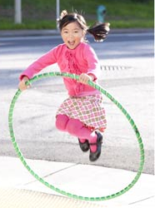
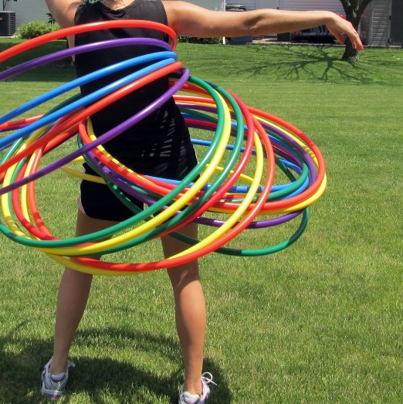
Can you be a super star skipper?
Can you hula as a group!
Are you ready for the
hula challenge?
Who can hula for the longest?
Who can hula with the most hoops?
Send us photos or videos of your challenge ideas to sspadmin@combertonvc.org or share them on the SSP Facebook or twitter page

Slide 2
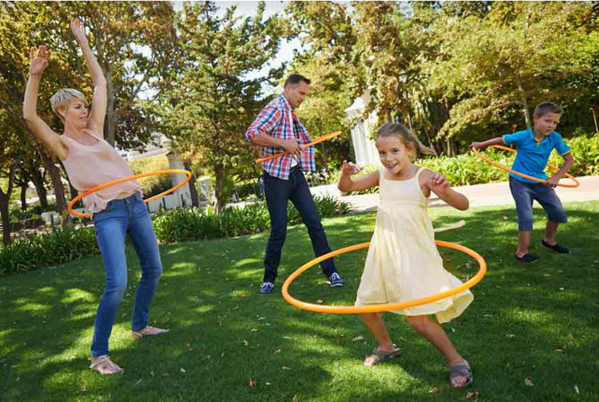
Active Play – Hula Challenge
Vid’s to inspire your kids!
https://www.youtube.com/watch?v=jGs-iv_0NAI
Awesome hula hooping records!
https://www.youtube.com/watch?v=0p9OBO9kFeY
German sets world record for planking whilst hula hooping!
https://www.youtube.com/watch?v=cB21akeRqjY Combine hula hooping with gymnastics.
https://www.youtube.com/watch?v=dqBK3wSoPxs
Huang Haimu takes hula hooping to another level!
Post videos of your challenge ideas on the SSP Facebook or twitter page or email to sspadmin@combertonvc.org

